Slide 1
GUI Feature

Slide 2
Goal
超一流的界面和易用性(和已有ROI工具比)
细致友好的用户界面是这个工具的最大的特色
综合性
综合各种功能是本工具的另一项特色
ROI 制作, ROI 分析
集成Functional Atlas
Manual fROI and automatic fROI

Slide 3
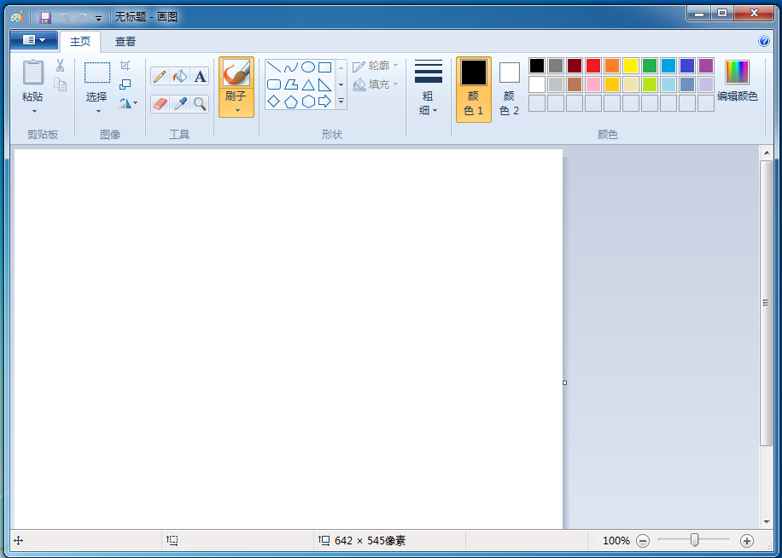

Slide 4
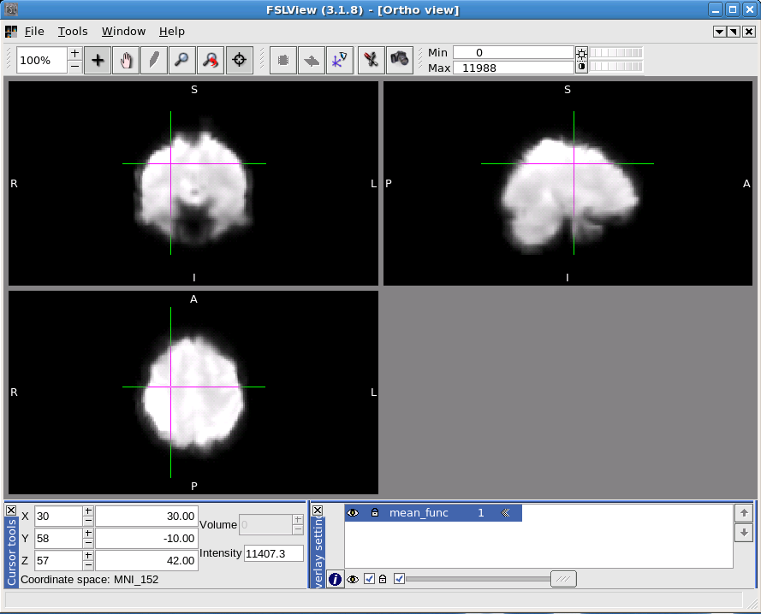

Slide 5
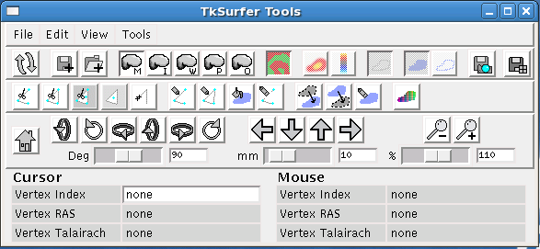
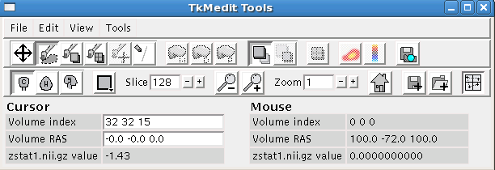

Slide 6
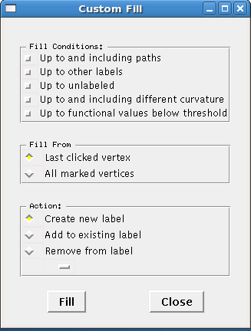

Slide 7
Basic feature
IO
Read/write/overlay
Save TIFF image
Edit
Select: free drawing, regular shape(size, color)
Brush: size, color
Undo/redo
Clear/reset
Setting
Color, size, thickness
View orientation(axial, coronal, sagittal )
Zoom in/out
Label style: outline and filled(color, thickness)
Information
coordinate, atlas ROI name

Slide 8
Advance feature
Image processing
Smoothing
Fill: color, boundary
Automatic clustering/Peak based clustering
merge, union/intersect, dilate/erode
Marker

Slide 9
Choice
Style
menu only
Toolbar only
Unified Menu + toolbar(win7 painter)
Separated Menu + toolbar
Priority
Which thing should be done prior to others?
Basic feature

Slide 10
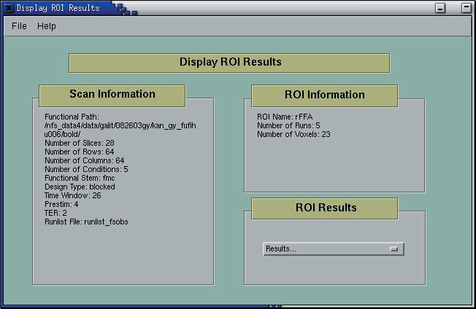
ROI analysis

Slide 11
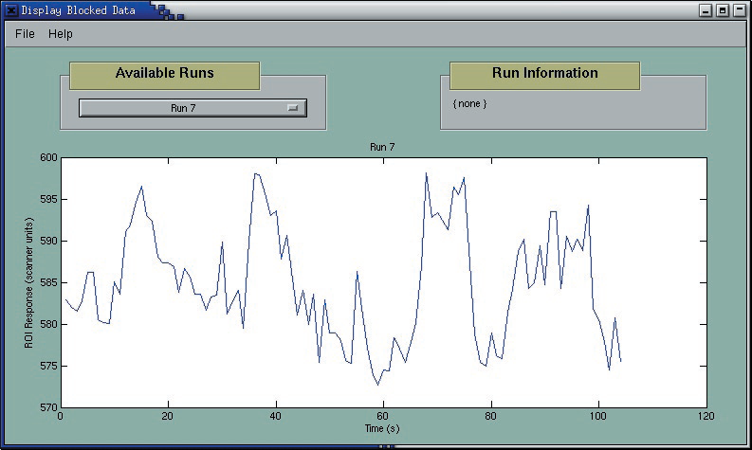

Slide 12
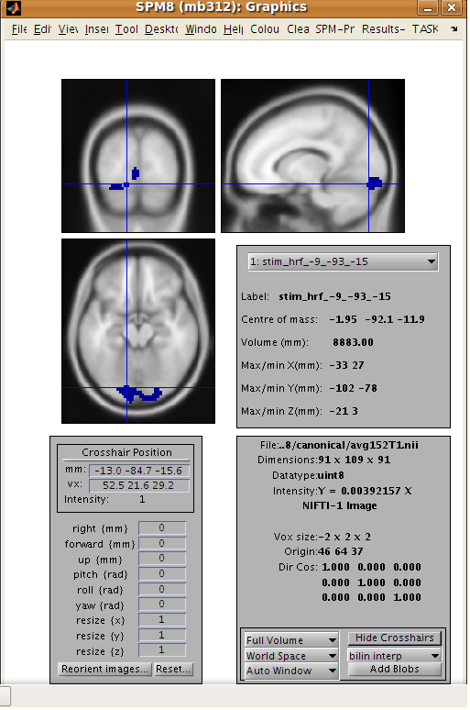

Slide 13
